Slide 1
Naplan Prep – Time/Angles/Triangles/Quadrilaterals
J.Wilson

Slide 2
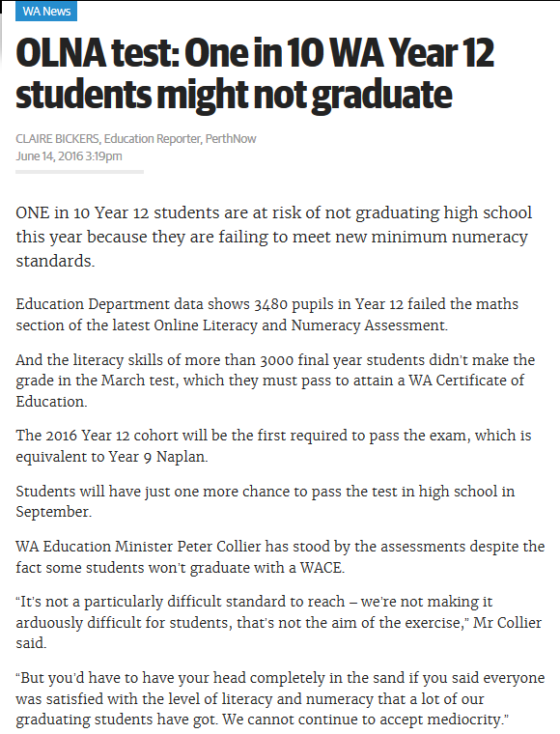

http://www.perthnow.com.au/news/western-australia/olna-test-one-in-10-wa-year-12-students-might-not-graduate/news-story/99e5aa25a7b8dfca7932dd17da62a22b
Notes:
Set – explain the importance to the student for doing well in Naplan in year 9. Reduces stress for year 11 ad 12 as OLNA becomes less of a problem.

Slide 3
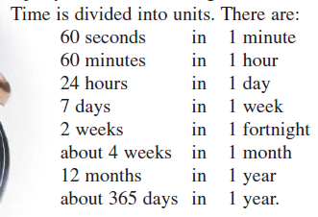
Time Calculations
Notes:
Go through time conversions- “Fists of 5” of thumbs up check to check everyone is okay with these and has seen then before.

Slide 4
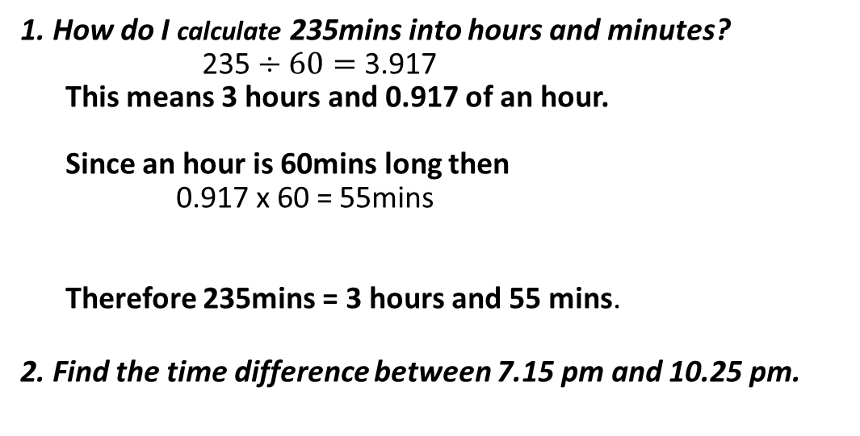
Step 1. Divide the total number of minutes by how many minutes are in 1 hour
1. How do I calculate 235mins into hours and minutes?
235 $÷60=$3.917
This means 3 hours and 0.917 of an hour.
Since an hour is 60mins long then
0.917 x 60 = 55mins
Therefore 235mins = 3 hours and 55 mins.
2. Find the time difference between 7.15 pm and 10.25 pm.
Step 2. Convert the decimal part to minutes by multiplying by 60
Step 3. Combine the answers together
 | Hours | Minutes
7:15pm
8:00pm
10:00pm
10:25pm
Total time
1. What is the difference between 1:15pm and 8pm
45
2. What is the difference between 8pm and 10pm
2
3. What is the difference between 10pm and 10:25pm
25
4. Add the minutes together and collect the hours
2
70
5. If the minutes add to give more than 60, readjust your answer.
2hrs and 70 mins = 3hrs and 10mins
Notes:
Modelling to work through on time calculations.

Slide 5
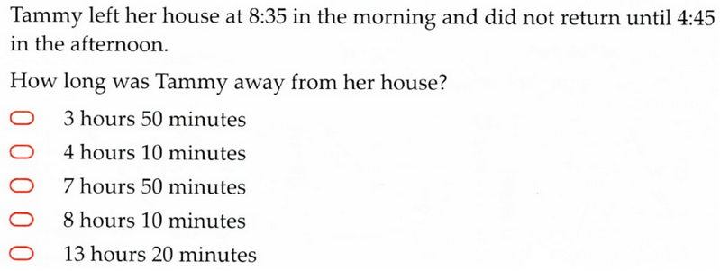
2016
Notes:
Guided practice- students attempt for 2minutes (can be with partner /group)

Slide 6
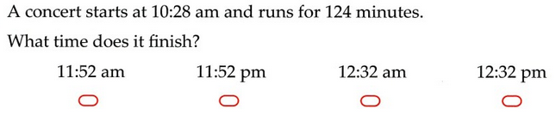
2015
Notes:
Guided practice- students attempt for 2minutes (can be with partner /group)

Slide 7
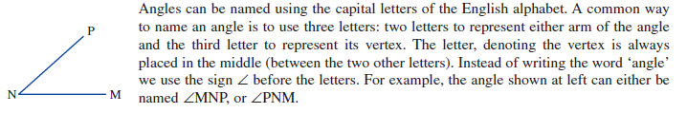
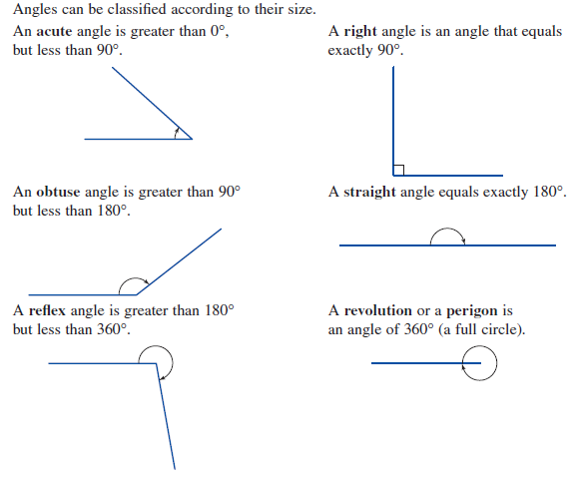
The letter, denoting the vertex is always placed in the middle. Instead of writing the word ‘angle’ we use the sign ∠ before the letters. For example, the angle shown at left can either be named ∠MNP, or ∠PNM.
Notes:
Notes and nomenclature on angles – seems to be common that they test for knowledge of terminology as much as maths ability so make sure you go through the terms and make sure students are aware of the terms.

Slide 8
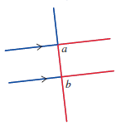

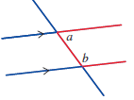
Corresponding angles are equal in size.
The position of corresponding angles is easy to remember it by the ‘F’ shape.
Alternate angles are equal in size
The position of alternate angles is seen by the ‘Z’ shape.
Co-interior angles add up to 180°.
remember it by the ‘C’ shape.
Notes:
Notes and nomenclature on angle relationships – seems to be common that they test for knowledge of terminology as much as maths ability so make sure you go through the terms and make sure students are aware of the terms.

Slide 9
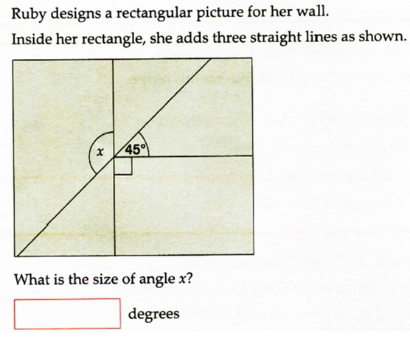
2016
Notes:
Guided practice- students attempt for 2minutes (can be with partner /group)

Slide 10
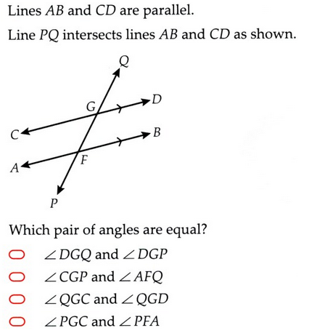
2016
Notes:
Guided practice- students attempt for 2minutes (can be with partner /group)

Slide 11
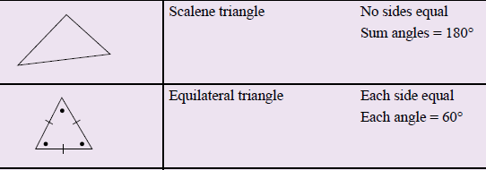
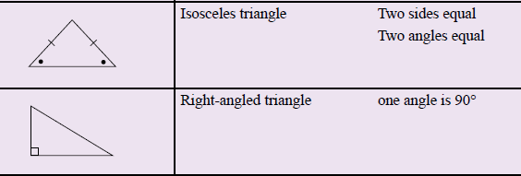
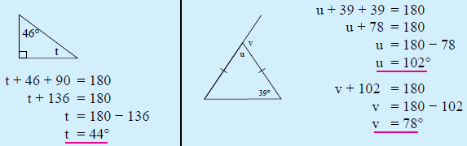
There are 4 types of triangles
The angles inside a triangle all add together to equal 180º.
We can use this to find the value of unknown angles
Notes:
Notes and nomenclature triangles – again it seems to be common that they test for knowledge of terminology as much as maths ability so make sure you go through the terms and make sure students are aware of the terms.

Slide 12
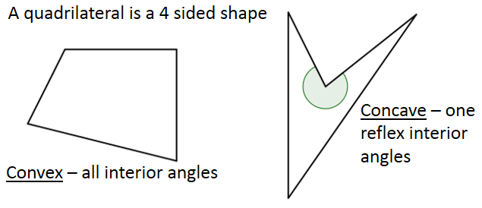

Slide 13
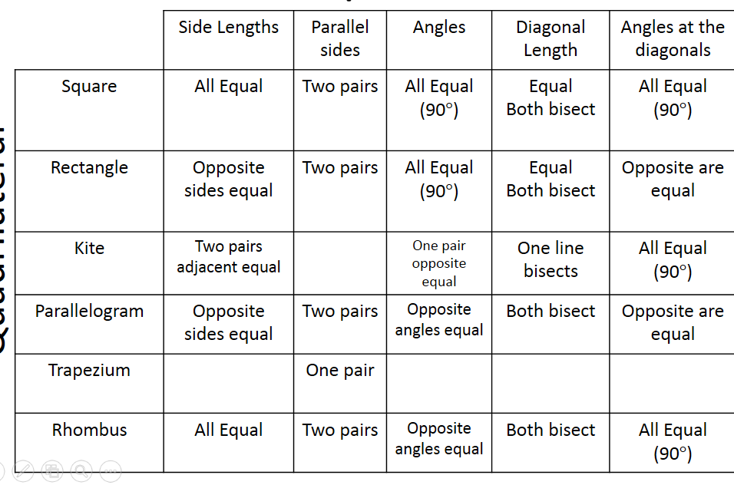

Slide 14
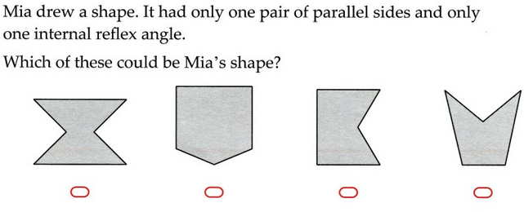
Notes:
Guided practice- students attempt for 2minutes (can be with partner /group)

Slide 15
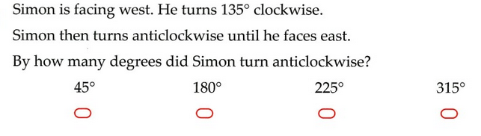
Notes:
Guided practice- students attempt for 2minutes (can be with partner /group)

Slide 16
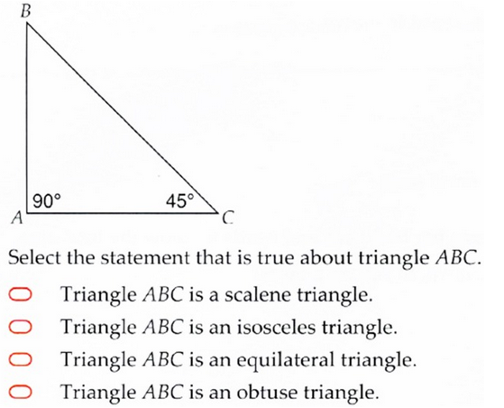
2016
Notes:
Guided practice- students attempt for 2minutes (can be with partner /group)

Slide 17
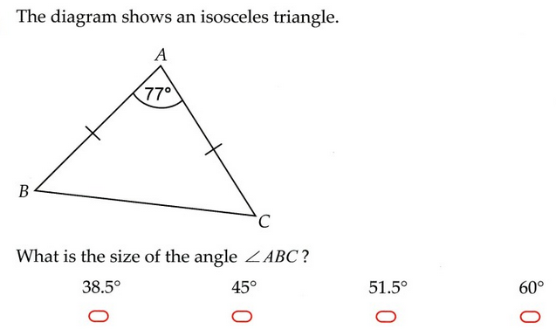
2015
Notes:
Guided practice- students attempt for 2minutes (can be with partner /group)

Slide 18
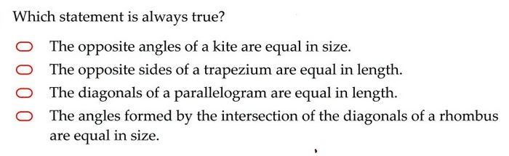
Notes:
Guided practice- students attempt for 2minutes (can be with partner /group)

Slide 19
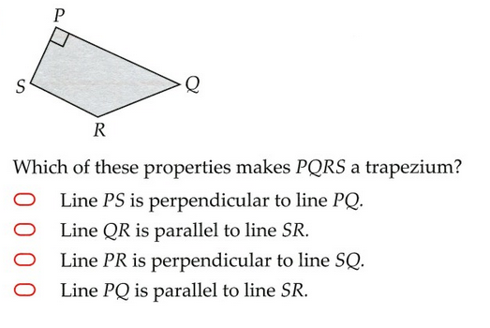
Notes:
Guided practice- students attempt for 2minutes (can be with partner /group)

Slide 20
Practice
Work together in a group and try to complete as many NAPLAN questions as you can in the remaining time.

Slide 21
Quick write
What are the steps to converting minutes to hours?
What are the 3 types of triangles.
Draw and name 4 types of quadrilateral.

